Slide 1
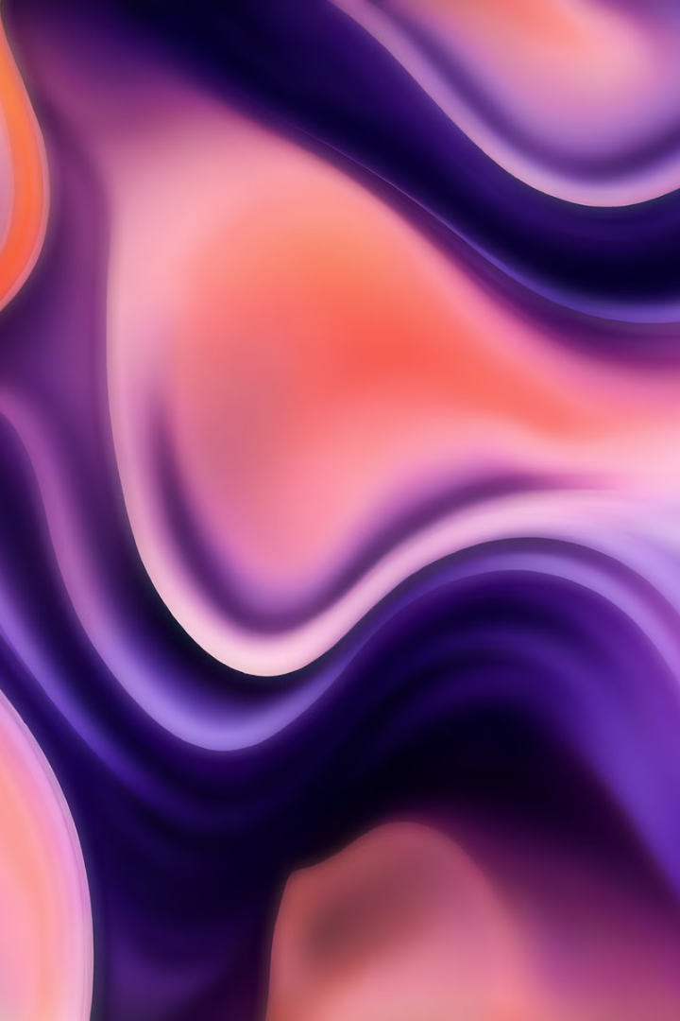
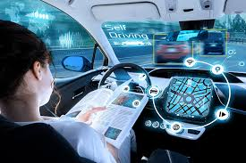
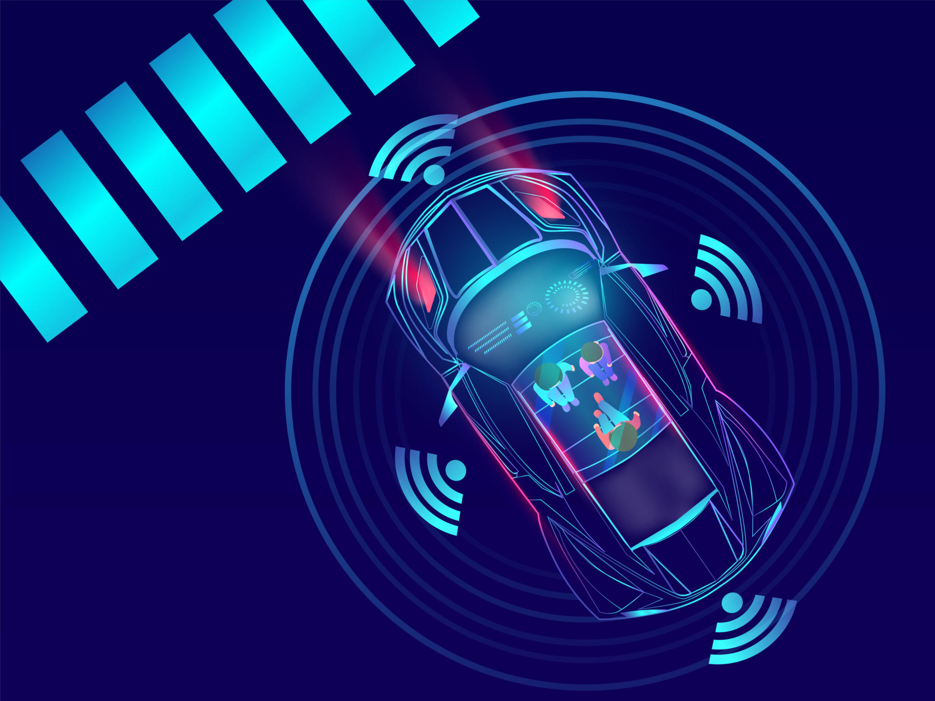
Domain-AIML Team Number-5 Title : SELF-DRIVING CAR SIMULATION
SIRI SURESHBABU - SM24NS00108
RENUKA - SM24NS00326
SHRI RAKSHA – SM24NS00332
IMRAN N PATWEGAR – SM24NS00344

Slide 2
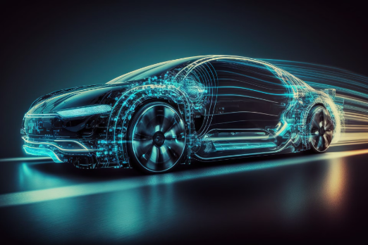
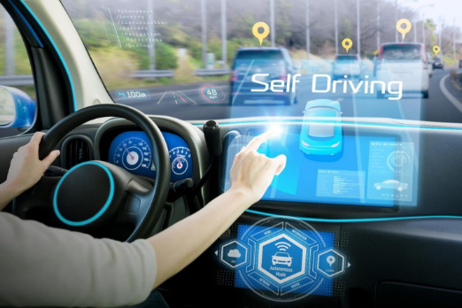

ABOUT PROJECT
WHY THIS ?
FEATURES
This project uses a deep learning model to predict steering angles for a self-driving car simulation.
It processes real-time images, speed, and throttle data using Flask and SocketIO for autonomous navigation.
TensorFlow/Keras handles model training, while OpenCV aids in image preprocessing
We chose this because self-driving technology is a cutting-edge application of AI and deep learning. It combines computer vision, real-time decision-making, and automation, making it both challenging and exciting. This project helps in understanding how AI can be used for autonomous navigation, which has real-world applications in transportation and safety.
Autonomous Driving
CNN-based Vision
Flask & SocketIO
Image Preprocessing
Dynamic Speed Control
RYMEC, ISE DEPT.

Slide 3
Methodology
Preprocessing
Deployment
Preparing data for CNN model training, including resizing, normalization, and augmentation.
Integrating the trained model into a Flask web application for live prediction.
Data Collection
Model Training
Gathering labeled images of diseased and healthy cotton plants.
Training a CNN model to recognize patterns in the data and classify diseases.
RYMEC, ISE DEPT.

Slide 4

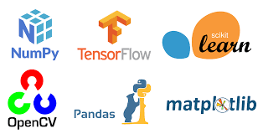


TECHNOLOGY STACK
Programming Language: Python
Frameworks: TensorFlow, OpenCV
Libraries: NumPy, Pandas, Matplotlib
Simulator: Udacity Self-Driving Car Simulator
Deployment: Eventlet for real-time server handling
Backend Server: Flask + SocketIO
RYMEC, ISE DEPT.

Slide 5
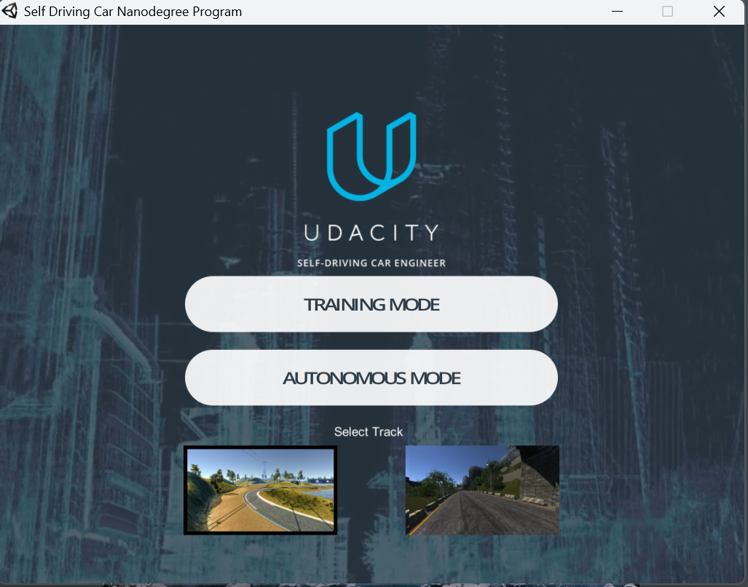
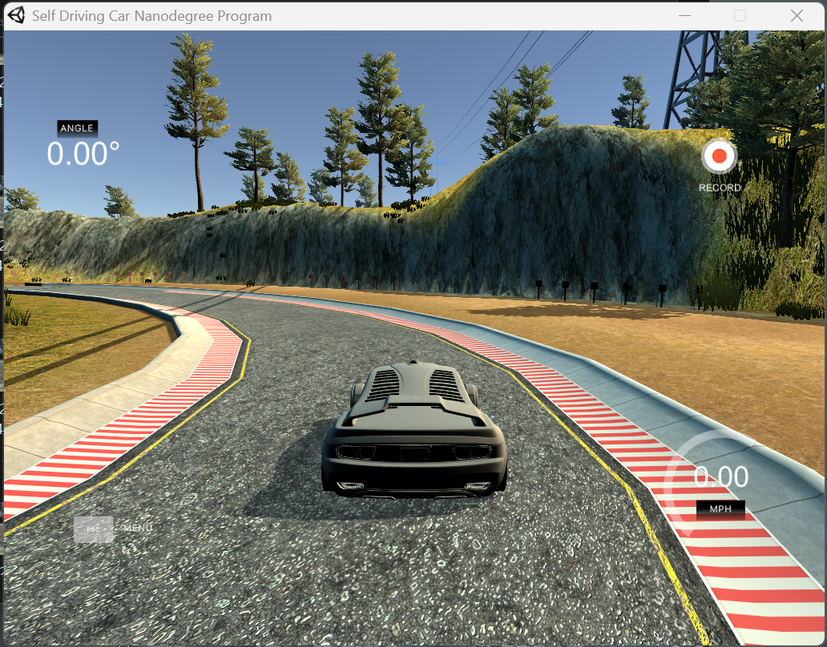
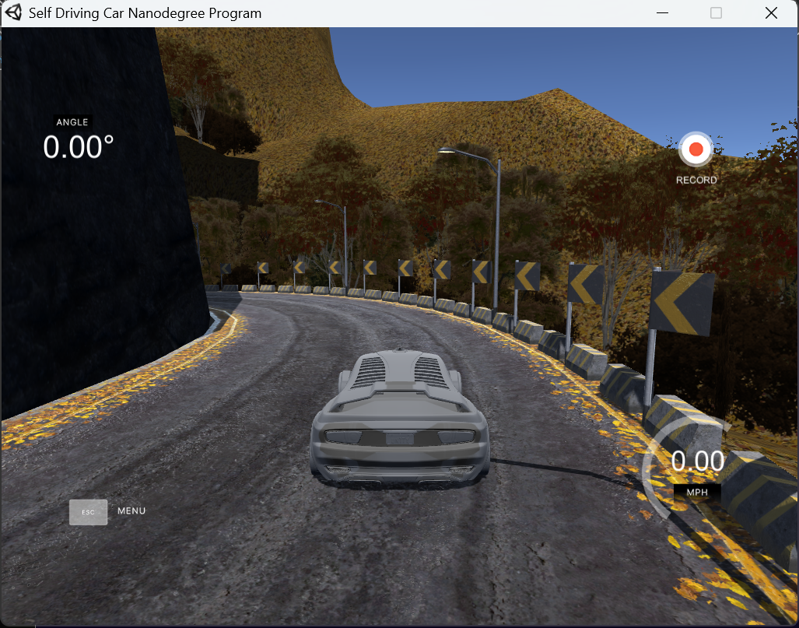
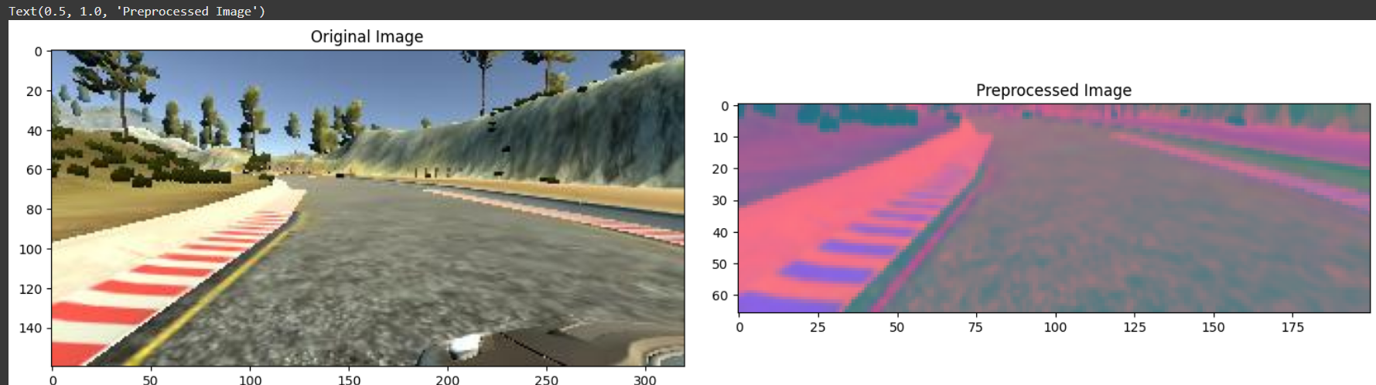
SCREENSHOTS
RYMEC, ISE DEPT.

Slide 6

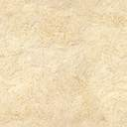
Individual Contributions
Team Member’s Name | Contribution to the Project
Siri Sureshbabu | Developed AI model
Renuka | Data Collection & Analysis
Shri Raksha | Testing, Debugging & Documentation
Imran N Patwegar | Integrated the project with a simulator
THANK YOU ☺
RYMEC, ISE DEPT.

